Slide 1
Macroeconomics ECON 101
Long-Run Economic Growth: Sources and Policies
(Chapter 7)
Instructor: Muhebullah Karimzada
Notes:
If this PowerPoint presentation contains mathematical equations, you may need to check that your computer has the following installed:
1) MathType Plugin
2) Math Player (free versions available)
3) NVDA Reader (free versions available)

Slide 2
Obtaining Economic Growth
In the previous chapter, we looked at ways to measure economic growth in the long and short terms.
In this chapter, we will consider the effects of different government policies on long-term economic growth.
Economic growth is not inevitable; history has seen long periods of stagnation with no sustained increases in output per capita.
Why have some countries been able to achieve rapidly increasing real GDP per capita, while other countries have failed to keep pace?
Our goal in this chapter is to develop a model of economic growth to help answer questions such as this.

Slide 3
The Industrial Revolution
Sustained economic growth did not really begin until the Industrial Revolution, the application of mechanical power to the production of goods and services which began in England around the year 1750.
Before this, production of most goods had relied on human or animal power.
The use of mechanical power allowed England and other countries—like the United States, France, and Germany—to begin to experience long-run economic growth.

Slide 4
Table 7.1 The Effects of Different Growth Rates on Living Standards
Country | Real G D P per Capita, 1960 (2017 U.S. dollars) | Growth in Real G D P per Capita, 1960–2019 | Real G D P per Capita, 2019 (2017 U.S. dollars)
Ghana | $4,408 | 0.4% | $5,546
Mexico | 6,072 | 1.9 | 19,308
Turkey | 5,051 | 2.9 | 26,700
SOURCES: Authors’ calculation from data in Robert C. Feenstra, Robert Inklaar, and Marcel P. Timmer, “The Next Generation of the Penn World Table,” American Economic Review, October 2015, Vol. 105, No. 10, p p. 3150–3182 (data available at www.ggdc.net/pwt.)
Small annual differences in growth rates result in dramatic differences in living standards even after just ~50 years.

Slide 5
Why Do Growth Rates Matter?
A country that grows too slowly fails to raise living standards.
This doesn’t just mean iPhones and flat-screen TVs.
In high-income countries, 6 or fewer out of 1,000 babies die before age one. In the poorest countries, the rate is more than 50 out of 1,000.
Poor growth has resulted in previously rich countries like Argentina lagging behind, with higher rates of poverty, lower life expectancy, and higher infant mortality than their prior peers.

Slide 6
Differences in Incomes Across Countries
Economists often divided the world economies into two groups:
The high-income countries, sometimes also referred to as the industrial countries including Australia, Canada, Japan, New Zealand, the United States, and the countries of Western Europe.
The lower-income countries, or developing countries, including most of the countries in Africa, Asia and Latin America.
The 1980s and 1990s have seen a small group of countries like Singapore, South Korea, and Taiwan began to experience high growth rates; these are often referred to as newly industrializing countries.
Real GDP per capita is markedly different across the world, even after correcting for cost of living differences. In 2020, it ranged from a high of $173,688 in the European country of Monaco to a low of $238 in the African country of Burundi.

Slide 7
What Determines How Fast Economies Grow?
7.2 Learning Objective
Use the economic growth model to explain why growth rates differ across countries.
An economic growth model explains growth rates in real GDP per capita over the long run.
As we saw in the last chapter, the key to this is labour productivity: The quantity of goods and services that can be produced by one worker or by one hour of work.
Two main factors affect labour productivity:
The quantity of capital available to workers and
The level of technology.
So, our model will concentrate on changes in the quantity of capital and technological change: A change in the quantity of output a firm can produce using a given quantity of inputs.

Slide 8
Sources of Technological Change
There are three main sources of technological change:
Better machinery and equipment.
Inventions like the steam engine, machine tools, electric generators, and computers have allowed faster economic growth.
Increases in human capital
Human capital is the accumulated knowledge and skills that workers acquire from education and training or from their life experiences.
Better means of organizing and managing production
If managers can do a better job of organizing production, then labour productivity can increase.

Slide 9
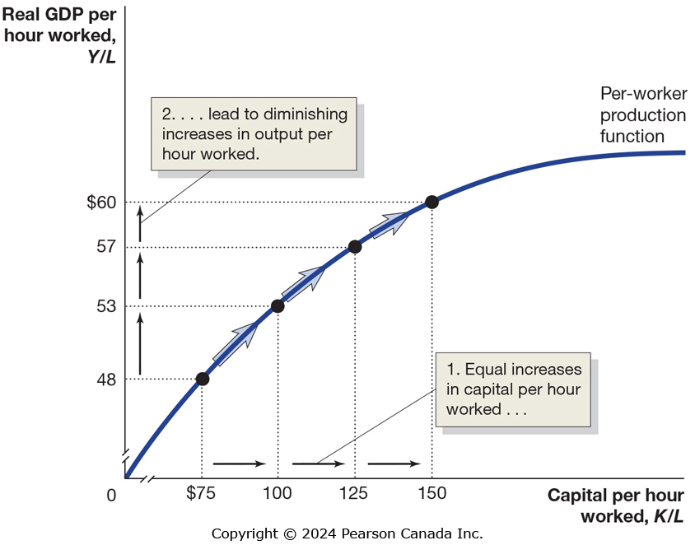
Figure 7.3 The Per-Worker Production Function
Suppose we wanted to describe a per-worker production function: the relationship between real GDP per hour worked, and capital per hour worked, holding the level of technology constant.
The first units of capital would be the most effective, allowing output per hour to increase the most.
Subsequent increases would result in diminishing returns: smaller increases in output resulting from increasing one factor of production progressively higher while keeping the other factors of production constant.

Slide 10
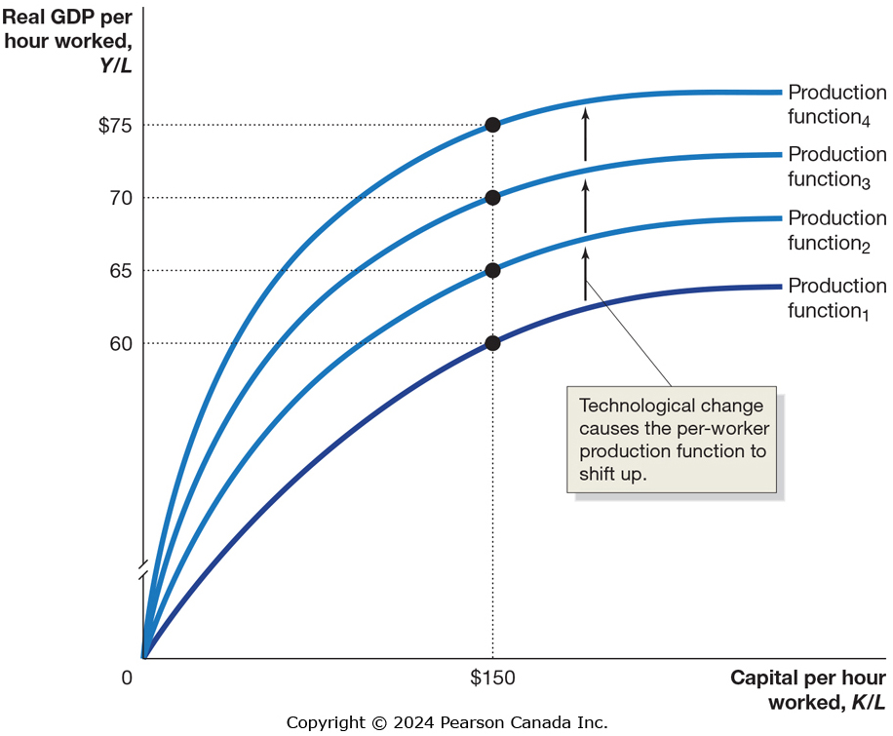
Figure 7.4 Technological Change Increases Output per Hour Worked (1 of 2)
If a country is relatively lacking in capital—like many of the developing countries—increases in capital will be very effective at increasing real G D P per capita.
In countries where the amount of capital is already relatively high, technological change becomes a more effective way to increase output per hour.

Slide 11
Figure 7.4 Technological Change Increases Output per Hour Worked (2 of 2)
While growth through improving capital per hour can be effective, it is necessarily limited by diminishing returns.
Technological change does not have this limitation.
In the long run, a country will experience an increasing standard of living only if it experiences continuing technological change.

Slide 12
New Growth Theory
The model of economic growth we have been using was first developed by Nobel Laureate Robert Solow in the 1950s.
According to Solow, productivity growth is the key factor in explaining long-run growth in real GDP per capita but the model didn’t explain what determines productivity growth.
Solow did not explain technological change, instead treating it as the result of chance scientific discoveries.
Paul Romer developed the new growth theory, a model of long-run economic growth that emphasizes that technological change is influenced by economic incentives and so is determined by the working of the market system.

Slide 13
New Growth Theory and Knowledge Capital
Romer argues that the accumulation of knowledge capital is a key determinant of economic growth. Increases in knowledge capital result from research and development and other technological advances.
Physical capital is rival and excludable—a private good—and this results in its diminishing returns.
But knowledge capital is nonrival and nonexcludable—a public good—and so results in increasing returns—not at the firm level but at the economy level.

Slide 14
Government’s Role in Knowledge Capital Generation
Public goods, such as knowledge capital can be affected by the free-rider problem: a person receiving benefits from goods and services without having to pay for it.
Example: Bell Labs’ development of transistor technology resulted in immense profits for other firms.
Because firms do not enjoy the entire benefit of their knowledge capital, they do not produce enough of it.
The public good nature of knowledge capital leads to a role for government policy in three ways:
Protecting intellectual property with patents and copyrights
Supporting research and development
Subsidizing education

Slide 15
Protecting Intellectual Property
Governments seek to protect intellectual property through the use of patents and copyrights.
Allowing firms to benefit from their own research and development increases their incentive to perform it.
Patents are the exclusive right to produce a product for a period of 20 years from the date the patent is filed. This period of time is designed to balance the chance for firm to benefit from its invention against the need of society to benefit from it.
Copyrights act similarly for creative works like books and films, granting the exclusive right to use the creation during and 70 years after the creator’s lifetime.

Slide 16
Supporting R&D and Subsidizing Education
Supporting research and development
Governments might perform research directly or subsidize researchers at institutions by providing grants and other payments through agencies. The governments also provide tax-incentives to firms performing R&D.
Subsidizing education
In order to perform research and development, workers need to be technically trained. If firms provide this training, they recoup the cost by paying workers lower wages, decreasing the incentive for workers to take such jobs.
A solution to this is to have the government subsidize education, as it does in all high-income countries.

Slide 17
Why Isn’t the Whole World Rich?
7.4 Learning Objective
Explain economic catch-up and discuss why many poor countries have not experienced rapid economic growth.
The economic growth model predicts that poor countries will grow faster than rich countries.
This is because:
The effect of additional capital is greater for countries with smaller capital stocks.
There are greater advances in technology immediately available to poorer countries.
Notes:
Given the history presented in the Chapter, another approach to take would be to ask “Why isn’t the whole world poor?”

Slide 18
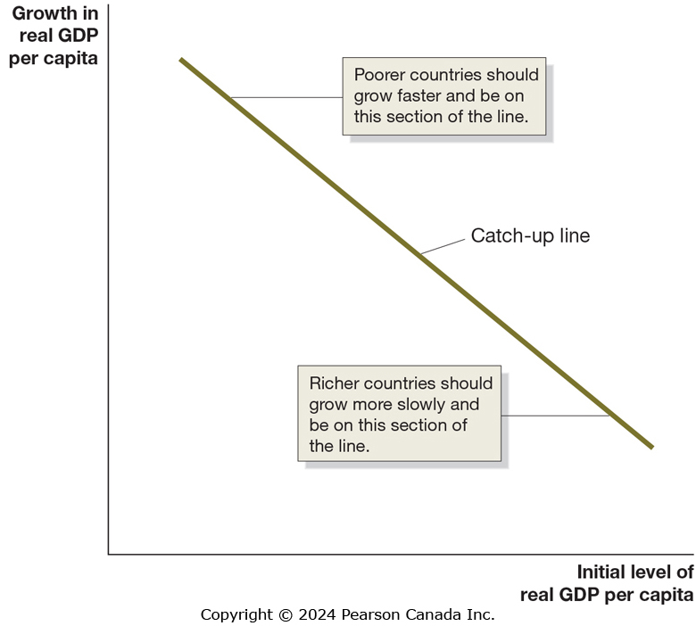
Figure 7.6 The Catch-Up Predicted by the Economic Growth Model
If poorer countries grow faster than richer ones, they will start to catch up to, or converge to, the richer countries.
Catch-up: The prediction that the level of GDP per capita (or income per capita) in poor countries will grow faster than in rich countries.

Slide 19
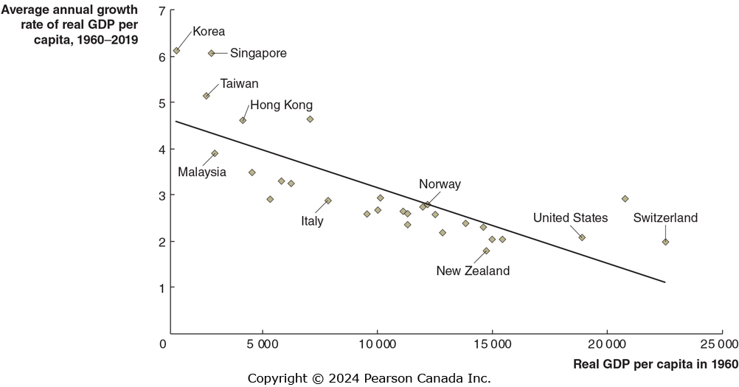
Figure 7.7 There Has Been Catch-Up Among High-Income Countries
Examining high-income countries, we appear to see strong evidence of the catch-up hypothesis.
Countries that were richer in 1960, like the U.S. and Switzerland, experienced lower growth rates over the next decades than countries that were initially poorer, like Hong Kong and Korea.
SOURCE: Authors’ calculations from data in Robert C. Feenstra, Robert Inklaar, and Marcel P. Timmer, “The Next Generation of the Penn World Table,” American Economic Review 105, no. 10 (October 2015): 3150–3182 (data available at www.ggdc.net/pwt).

Slide 20
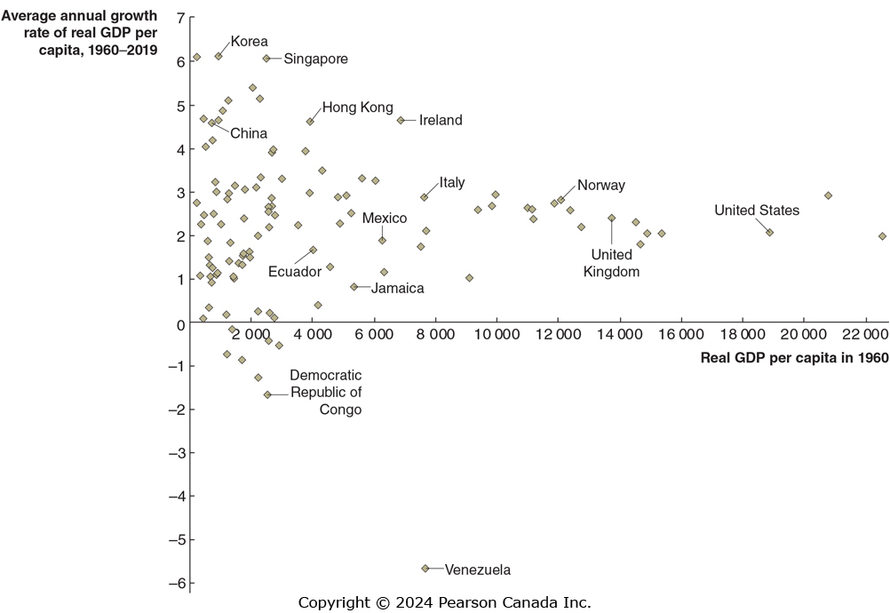
Figure 7.8 Most of the World Hasn’t Been Catching Up
SOURCE: Authors’ calculations from data in Robert C. Feenstra, Robert Inklaar, and Marcel P. Timmer, “The Next Generation of the Penn World Table,” American Economic Review 105, no. 10 (October 2015): 3150–3182. Federal Reserve Bank of St. Louis.
However, if we extend the set of countries to all countries for which statistics are available, our catch-up model appears to be worthless.
We need to address the failures of the catch-up model.

Slide 21
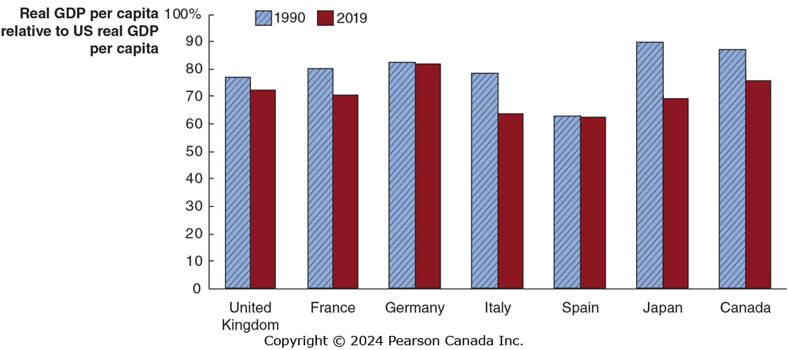
Figure 7.9 Other High-Income Countries Have Stopped Catching up to the United States
SOURCE: Authors’ calculations from data in Organisation for Economic Co-operation and Development, stat.oecd.org.
The blue bars show real G D P per capita in 1990 relative to the United States.
The red bars show real G D P per capita in 2019 relative to the United States.
In each case, the red bar is equal or lower; these countries are not catching up to the United States. Why?

Slide 22
Why are High-Income Countries Not Catching Up to the U.S.?
A combination of reasons explain this:
U.S. labour markets are relatively flexible; hiring and firing workers is relatively unrestricted by government regulation.
Similarly, U.S. workers tend to enter the work force sooner and retire later than do workers in Europe.
The U.S. financial system is relatively efficient, and the high volume of trading ensures high liquidity, making the U.S. an attractive place to invest.
Small firms find obtaining capital relatively easy in the U.S. due to the advent of venture capital firms.

Slide 23
The Lack of Growth in Many Low-Income Countries
Economists point to four key factors in explaining why many low-income countries are growing so slowly:
Failure to enforce the rule of law
Wars and revolutions
Poor public education and health
Low rates of saving and investment
We will address each of these over the following slides.

Slide 24
Failure to Enforce the Rule of Law
The rule of law refers to the ability of a government to enforce the laws of the country, particularly with respect to protecting private property and enforcing contracts.
For entrepreneurs in a market economy to succeed, the government must guarantee property rights: the rights of individuals or firms mean they have the exclusive use of their property, including the right to buy or sell it.
Otherwise, entrepreneurs will not risk starting a business.
Also important is an independent court system to enforce contracts.

Slide 25
Other Reasons for Lack of Growth in Poor Countries
Wars and revolutions
Wars and revolutions make investment and technological growth difficult.
Example: Sri Lanka’s real GDP per capita was the same in 1991 that it was in 1969 due to a civil war between the government and the Tamil minority.
When it returned to peace, it experienced growth: 4.5 percent per year, from 2009 to 2019.
Poor public education and health
With weak public schools and poor health care, workers are less productive.
Low rates of saving and investment
Undeveloped and insecure financial systems create a “vicious cycle” of low savings and investment, preventing growth.
Notes:
Vicious Cycle of Poverty: Households have low incomes, they save very little. Because households save very little, few funds are available for firms to borrow. Lacking funds, firms do not invest in the new factories, machinery, and equipment needed for economic
growth. Because the economy does not grow, household incomes remain low, as do
their savings, and so on.

